Slide 1
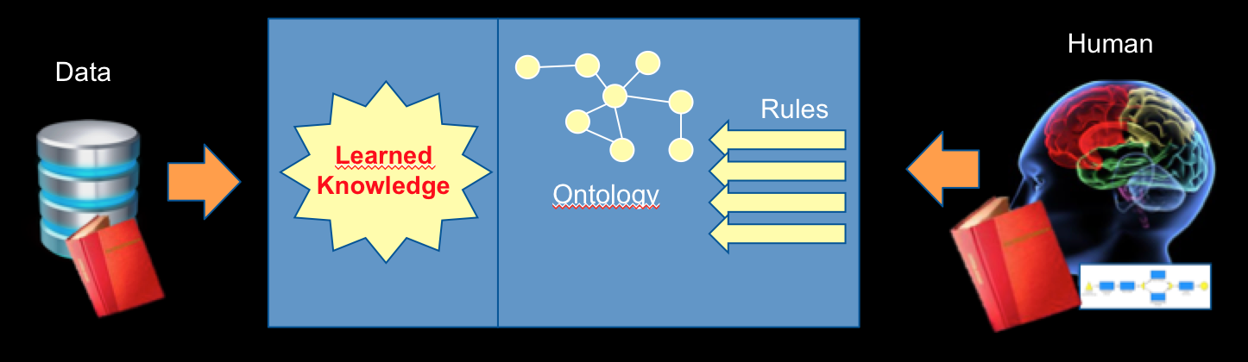
Combining Machine Learning with Knowledge Engineering
AAAI–MAKE (#aaaimake)
AAAI Spring Symposium Series
March 25–27, 2019 @ Stanford University, Palo Alto, California, USA
Aurona Gerber
University of Pretoria, South Africa

Slide 2
Machine Learning Knowledge Engineering
Fundamentally Different.
To paraphrase Frank: “… traditionally fields with very different foundations … similar to different religions that do not read each other’s works or attend each other’s meetings …”

Slide 3
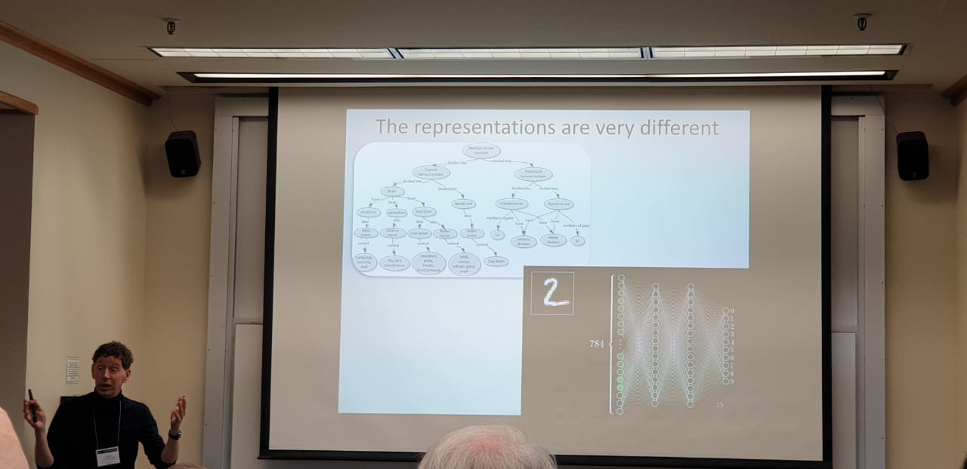
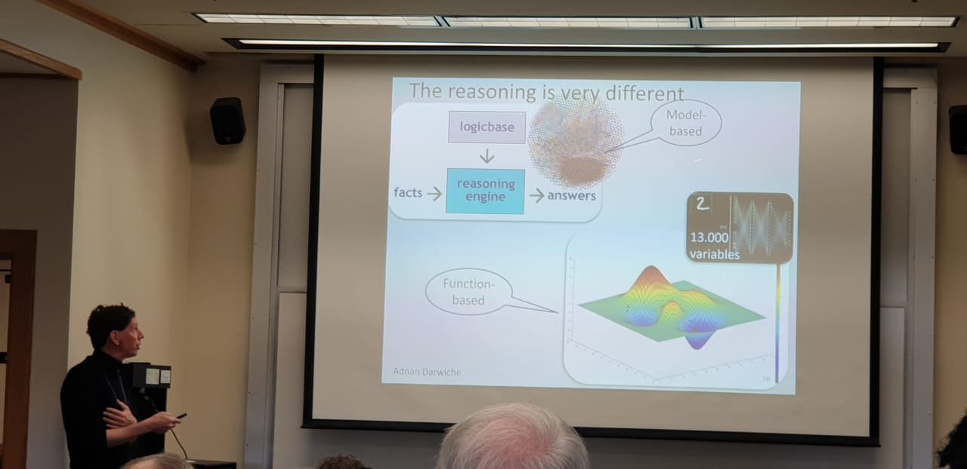
Machine Learning Knowledge Engineering
Fundamentally Different
Frank equated the fields with “…. different religions that do not read each other’s works or attend each other’s meetings …”

Slide 4
Combining Machine Learning with Knowledge Engineering
The AAAI-MAKE symposium aims to bring together researchers and practitioners from various communities of machine learning and knowledge engineering in order to work together on joint AI that is explainable, compliant and grounded in domain knowledge.

Slide 5
Combining Machine Learning with Knowledge Engineering
The AAAI-MAKE symposium aims to bring together researchers and practitioners from various communities of machine learning and knowledge engineering in order to work together on joint AI that is explainable, compliant and grounded in domain knowledge.
????

Slide 6
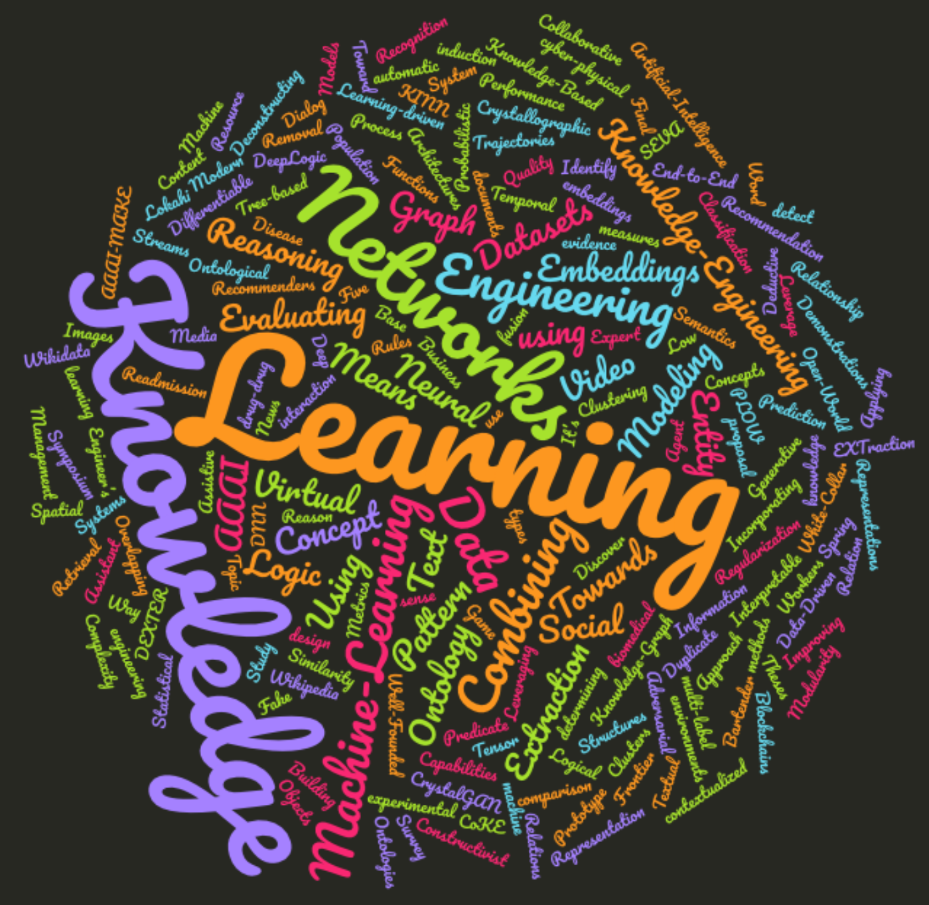

Slide 7
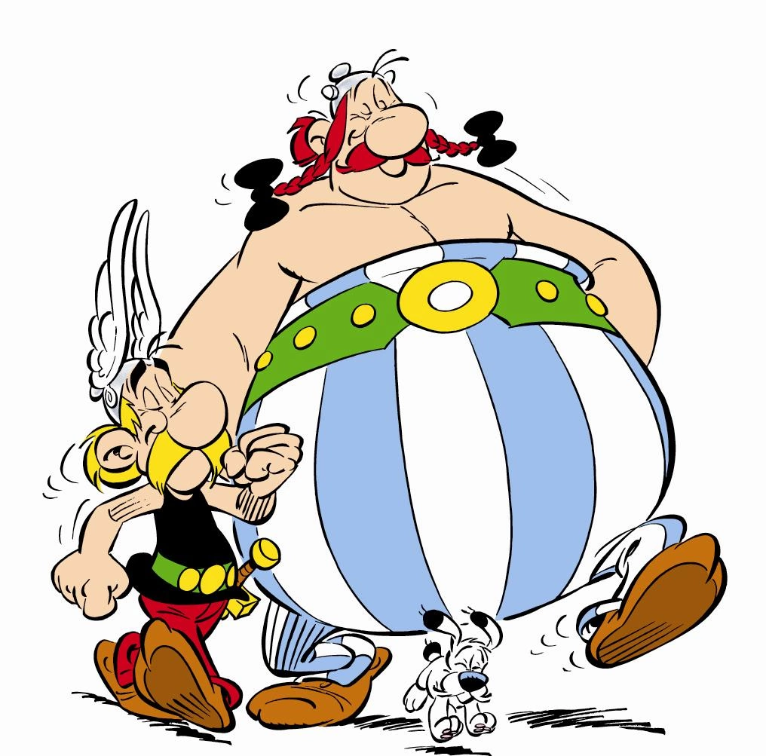
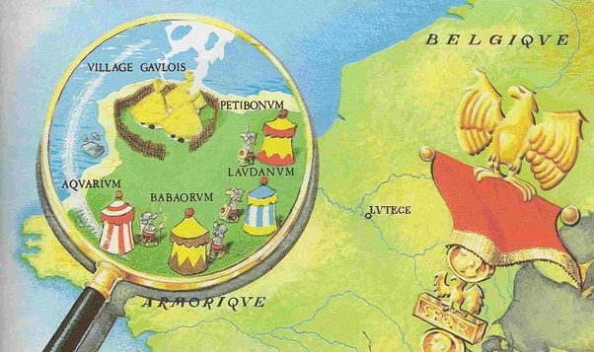
Quest for the answer

Slide 8
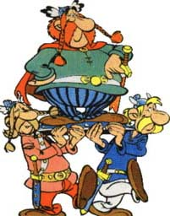
Asking the Chiefs

Slide 9
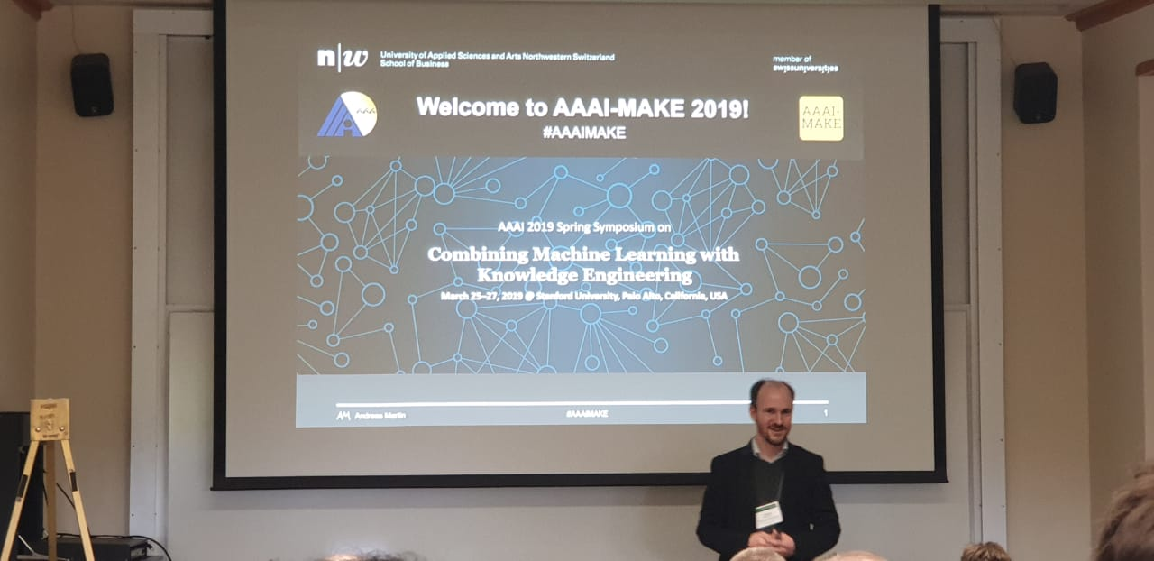

Slide 10
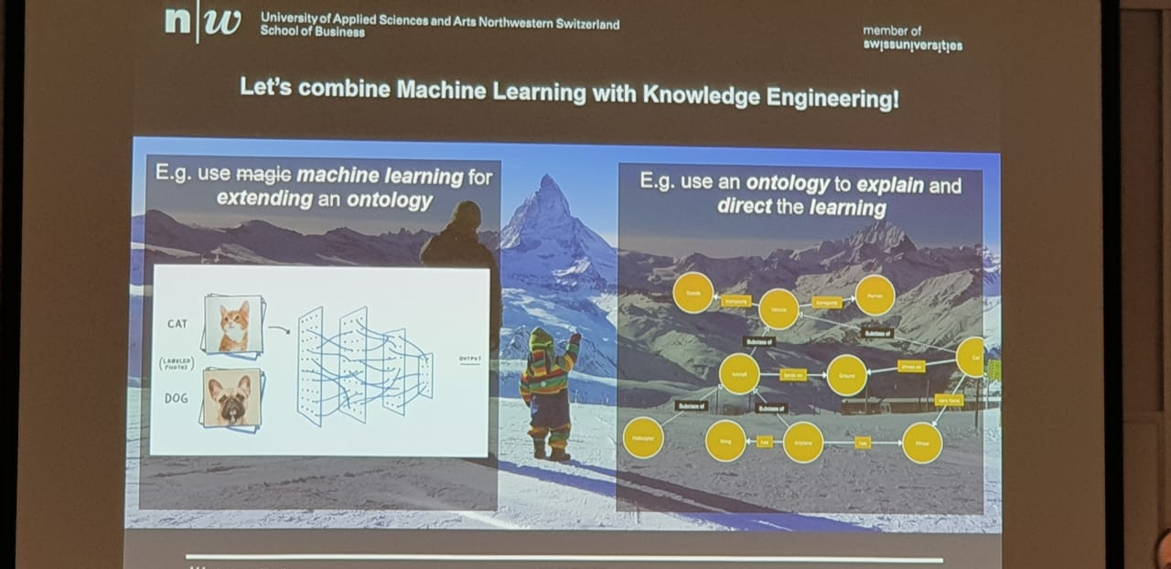

Slide 11

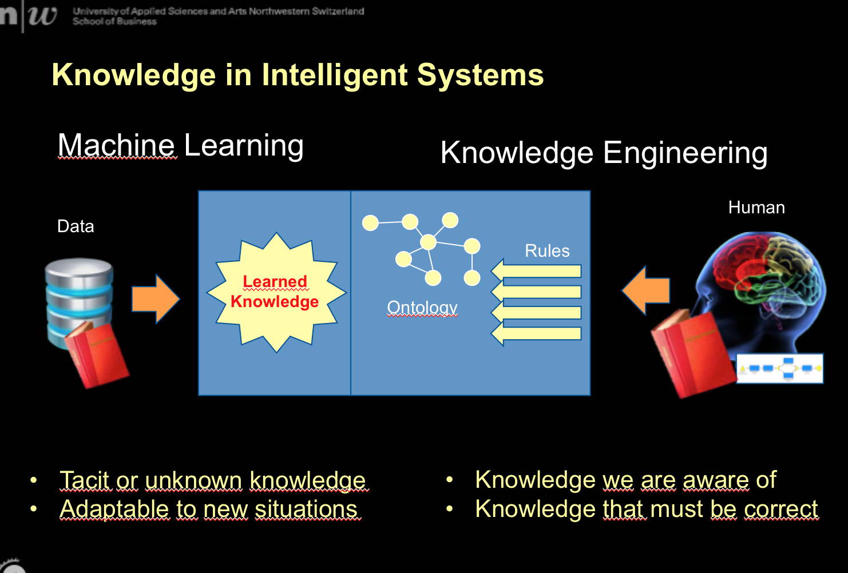

Slide 12
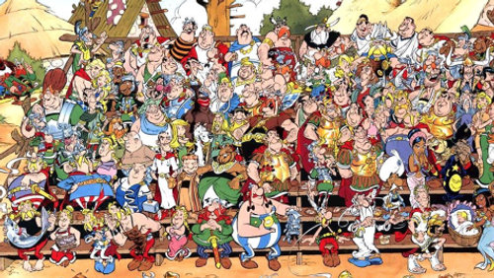
Asking the Village

Slide 13
Deconstructing the Final Frontier of Artificial-Intelligence: Five Theses for a Constructivist Machine-Learning
Knowledge engineering and machine learning for design and use in cyber-physical environments
From Demonstrations and Knowledge Engineering to a DNN Agent in a Modern Open-World Video Game
Leverage White-Collar Workers with AI
SEVA: A Systems Engineer’s Virtual Assistant
Virtual Bartender: A Dialog System Combining Data-Driven and Knowledge-Based Recommendation
Building Knowledge Base through Deep Learning Relation Extraction and Wikidata
Collaborative Learning of Concept Representations for Video Data
Representation and Retrieval of Images by Means of Spatial Relations Between Objects
Modularity as a Means for Complexity Management in Neural Networks Learning
Applying the Concept of Knowledge Blockchains to Ontologies
Combining Machine Learning with Knowledge Engineering to detect Fake News in Social Networks - A Survey
Improving Topic Modeling for Textual Content with Knowledge Graph Embeddings
The Lokahi Prototype: Toward the automatic Extraction of Entity Relationship Models from Text
DEXTER - Data EXTraction & Entity Recognition for Low Resource Datasets
CoKE : Word sense induction using contextualized knowledge embeddings
PLOW: Probabilistic Logic Over the Well-Founded Semantics
Using Predicate Information from a Knowledge Graph to Identify Disease Trajectories
A proposal for determining the evidence types of biomedical documents using a drug-drug interaction Ontology and Machine-Learning
On Datasets for Evaluating Architectures for Learning to Reason
Learning Temporal Rules from Knowledge-Graph Streams
Duplicate Removal for Overlapping Clusters: A Study Using Social Media Data
Performance measures fusion for experimental comparison of methods for multi-label Classification
CrystalGAN: Learning to Discover Crystallographic Structures with Generative Adversarial Networks
Tree-based Regularization for Interpretable Readmission Prediction
Towards an Assistive and Pattern Learning-driven Process Modeling Approach
DeepLogic: Towards End-to-End Differentiable Logical Reasoning
On the Capabilities of Logic Tensor Networks for Deductive Reasoning
KINN: Incorporating Expert Knowledge in Neural Networks
Learning and Engineering Similarity Functions for Business Recommenders and Clustering
Leveraging Wikipedia for Ontology Pattern Population from Text
Metrics for Evaluating Quality of Embeddings for Ontological Concepts
https://www.aaai-make.info/program

Slide 14
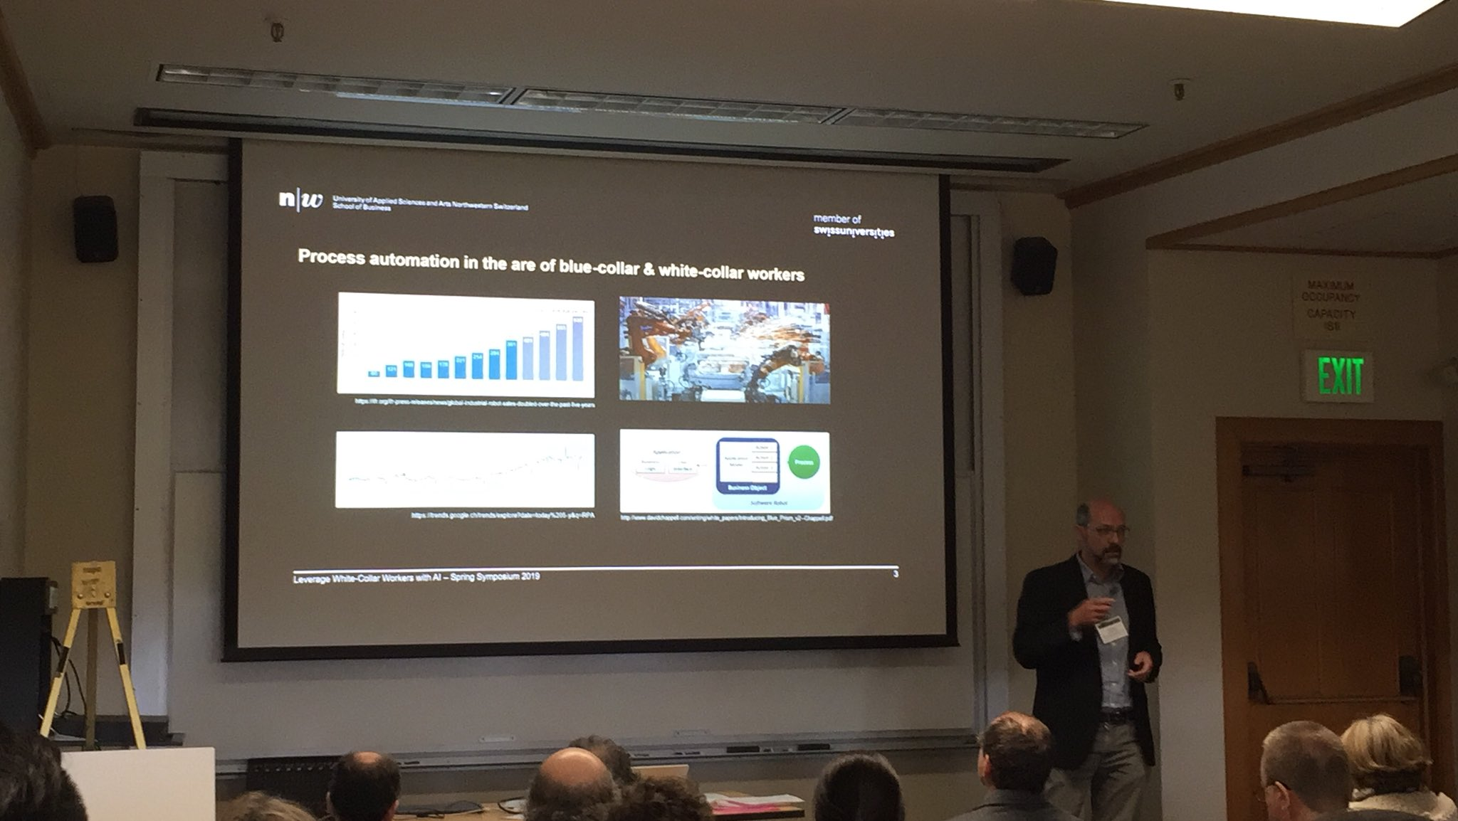
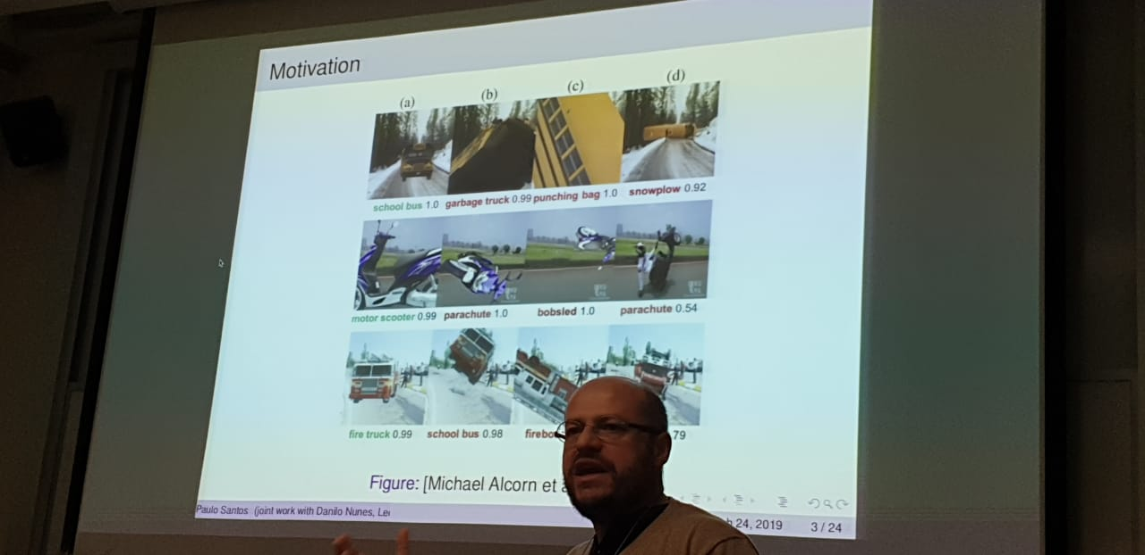
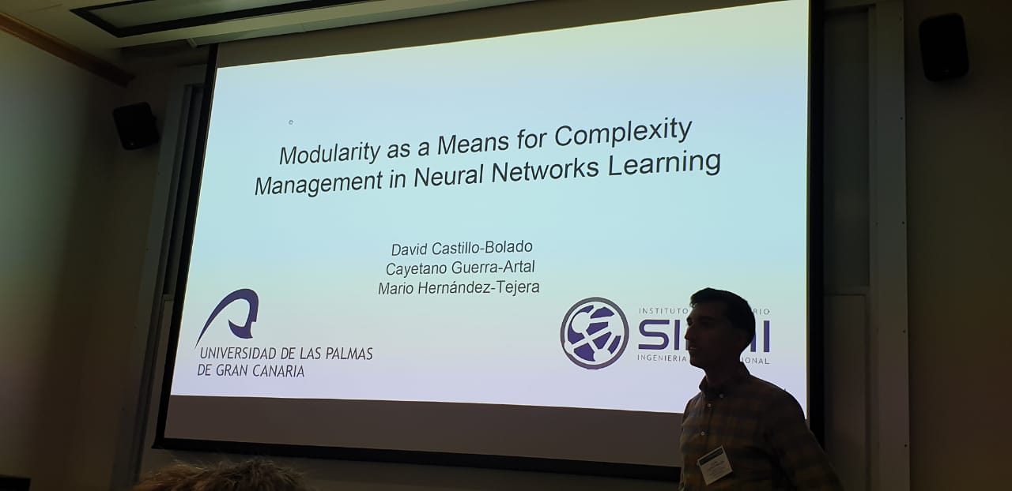

Slide 15
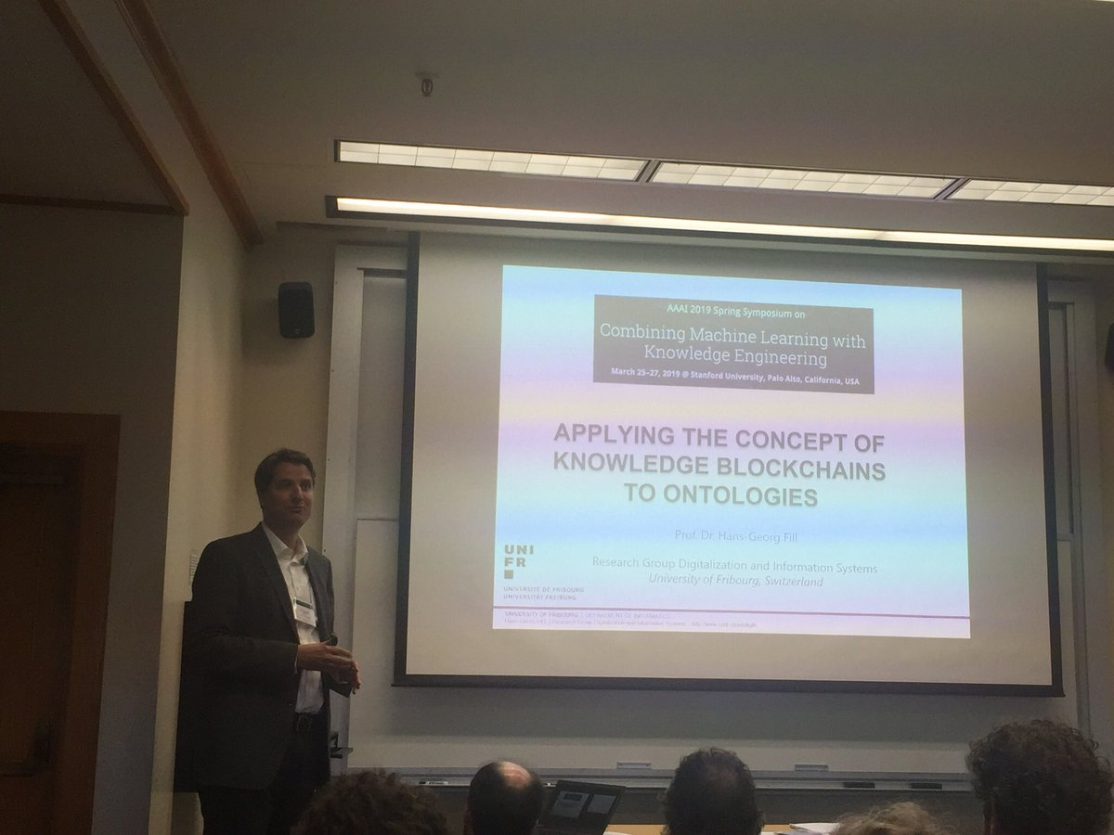
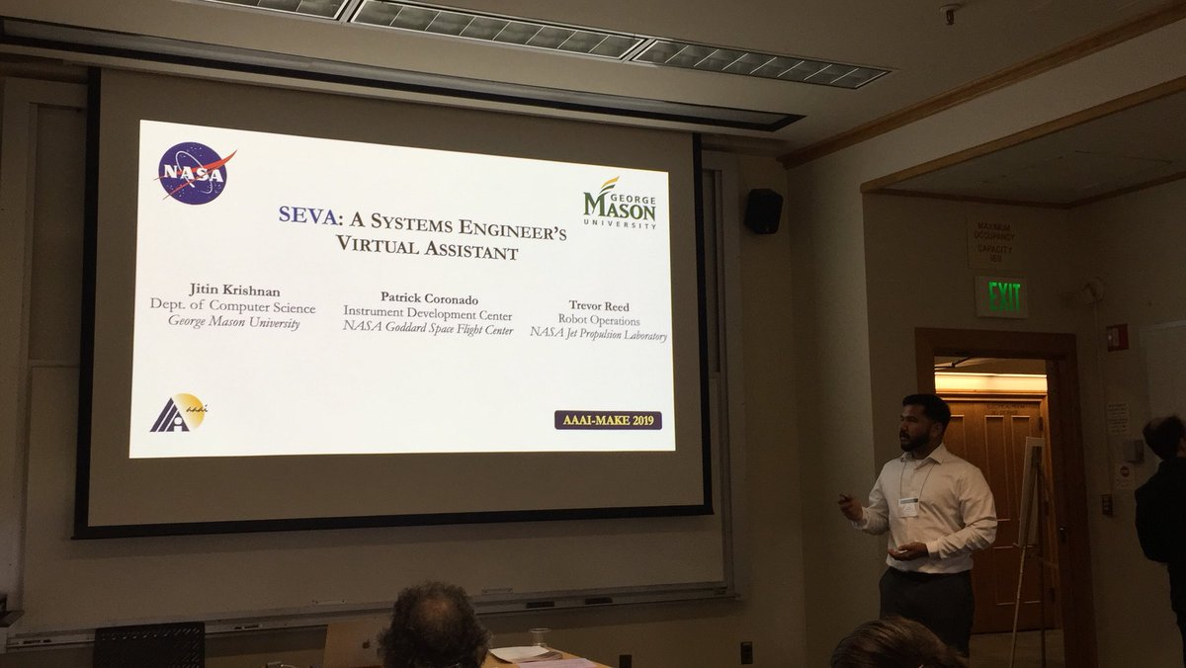
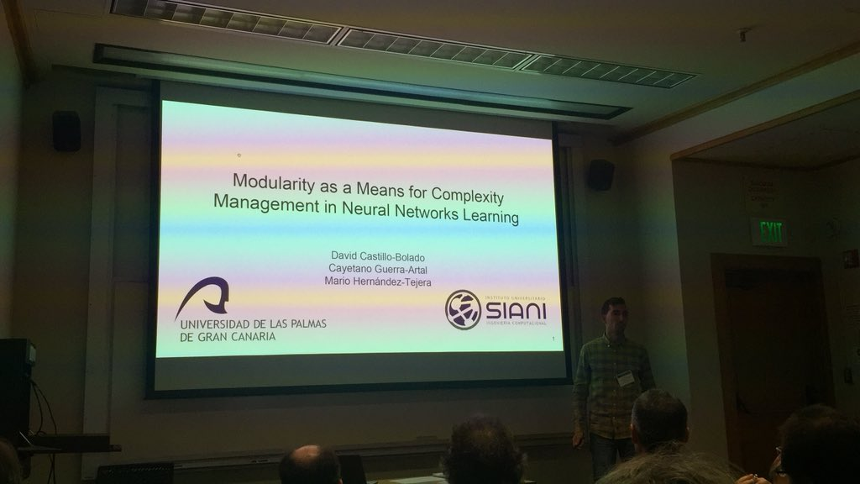

Slide 16
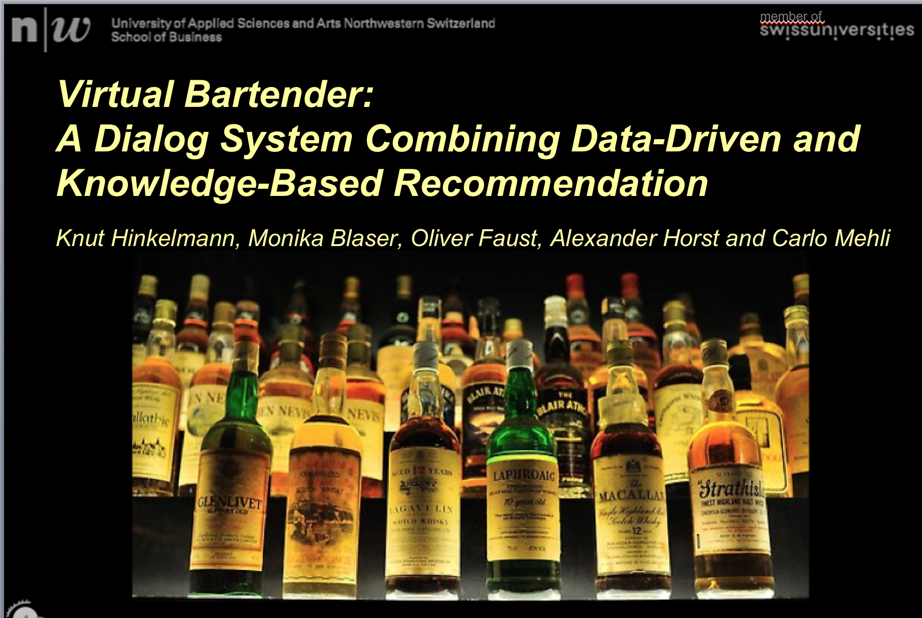

Slide 17
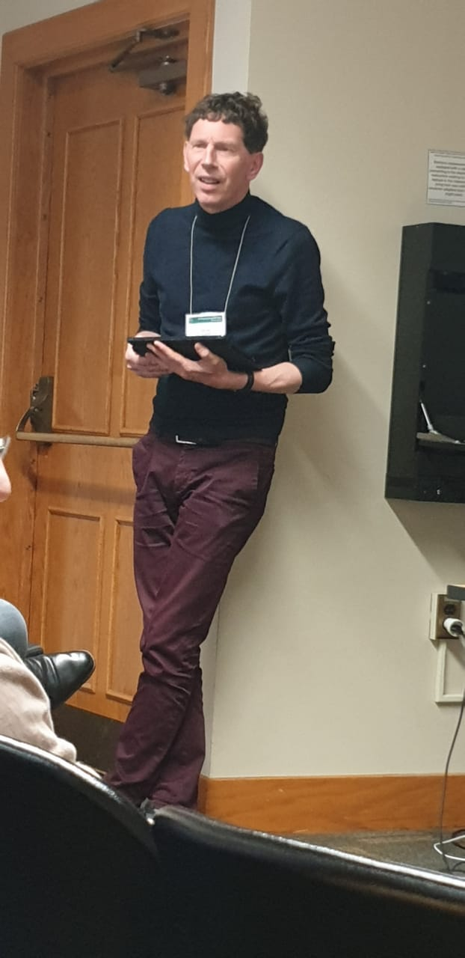
Summary of Papers & Presentations
Motivational Papers
Technique Papers
… especially solving domain specific problems
Visionary Papers
Hybrid Systems
Human-Machine Collaboration Systems
Notes:
Fake News
Disease Trajectories
Drug-drug interactions
Video data
Healthcare
CrystalGAN: Learning to Discover Crystallographic Structures

Slide 18
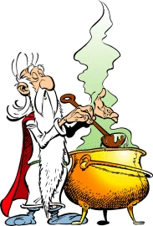
Asking the Wizards

Slide 19
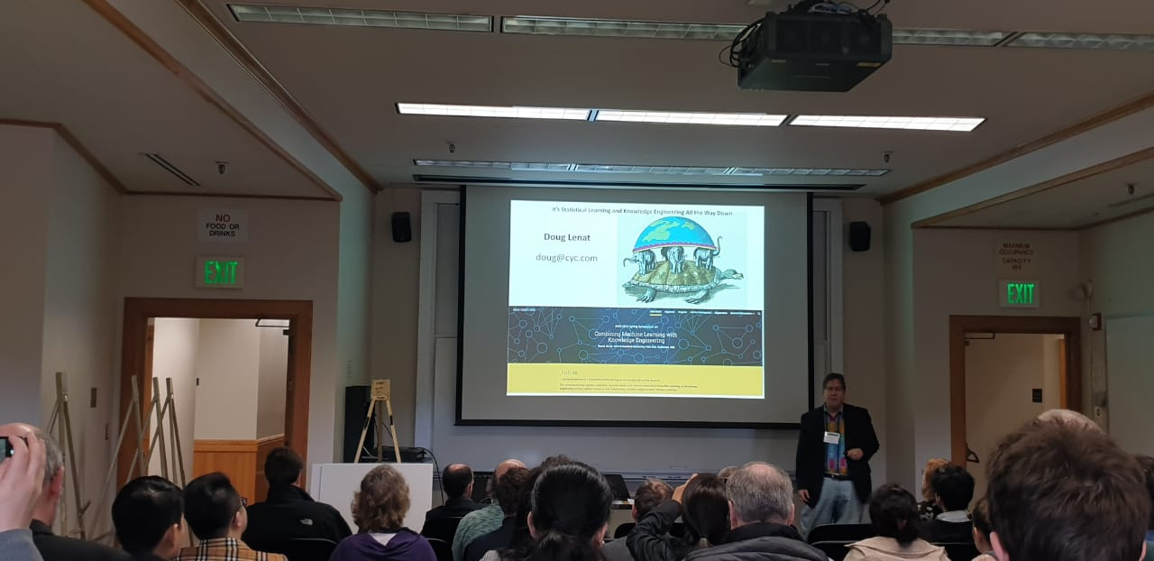
Doug Lenat: It’s Statistical Learning and Knowledge-Engineering All the Way Down
Notes:
Douglas Bruce Lenat (born 1950) is the CEO of Cycorp, Inc. of Austin, Texas, and has been a prominent researcher^{[1]} in artificial intelligence;^{[2]} he was awarded the biannual IJCAI Computers and Thought Award in 1976 for creating the machine learning program, AM. He has worked on (symbolic, not statistical) machine learning (with his AM and Eurisko programs), knowledge representation,^{[3]} "cognitive economy",^{[4]} blackboard systems, and what he dubbed in 1984 "ontological engineering"^{[5]} (with his Cyc program at MCC and, since 1994, at Cycorp). He has also worked in military simulations,^{[6]} and numerous projects for US government, military, intelligence, and scientific organizations. In 1980, he published a critique of conventional random-mutation Darwinism.^{[7][8]} He authored a series of articles^{[9][10][11][12]} in the Journal of Artificial Intelligence exploring the nature of heuristic rules.
Lenat was one of the original Fellows of the AAAI, and is the only individual to have served on the Scientific Advisory Boards of both Microsoft and Apple. He is a Fellow of the AAAS, AAAI, and Cognitive Science Society, and an editor of the J. Automated Reasoning, J. Learning Sciences, and J. Applied Ontology. He was one of the founders of TTI/Vanguard in 1991 and remains a member of its advisory board still in 2017. He was named one of the Wired 25.^{[13]}

Slide 20
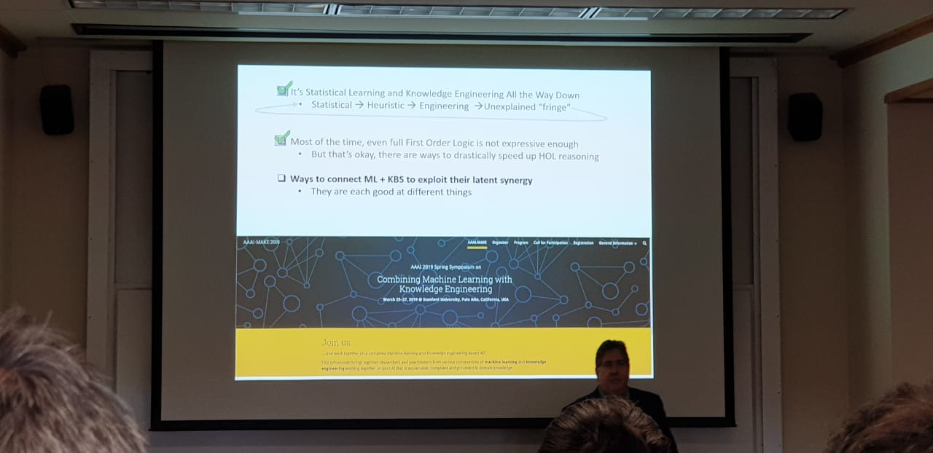

Slide 21
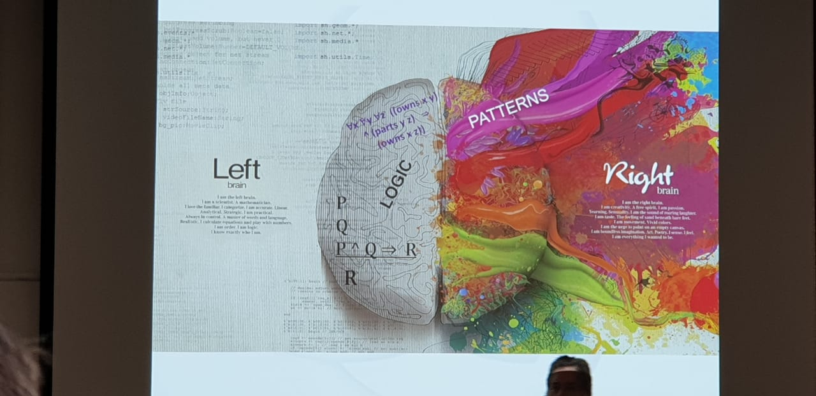

Slide 22
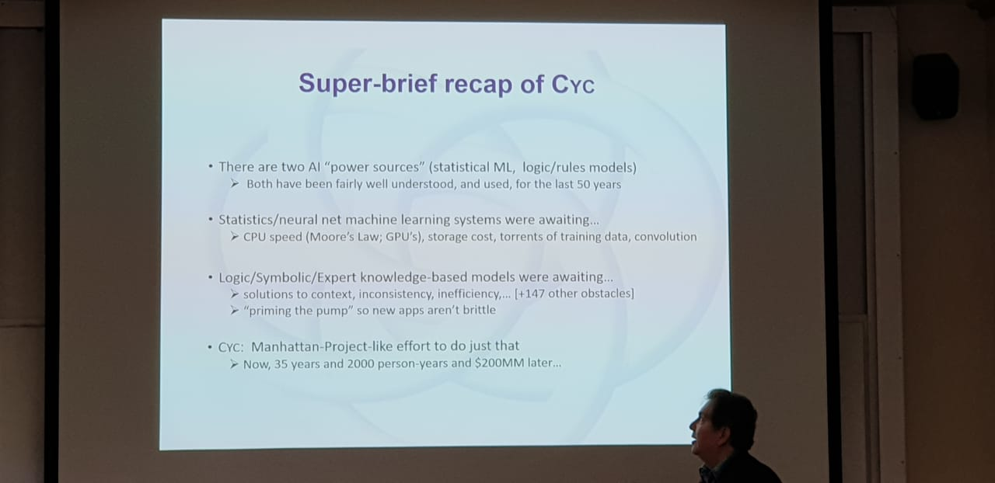

Slide 23
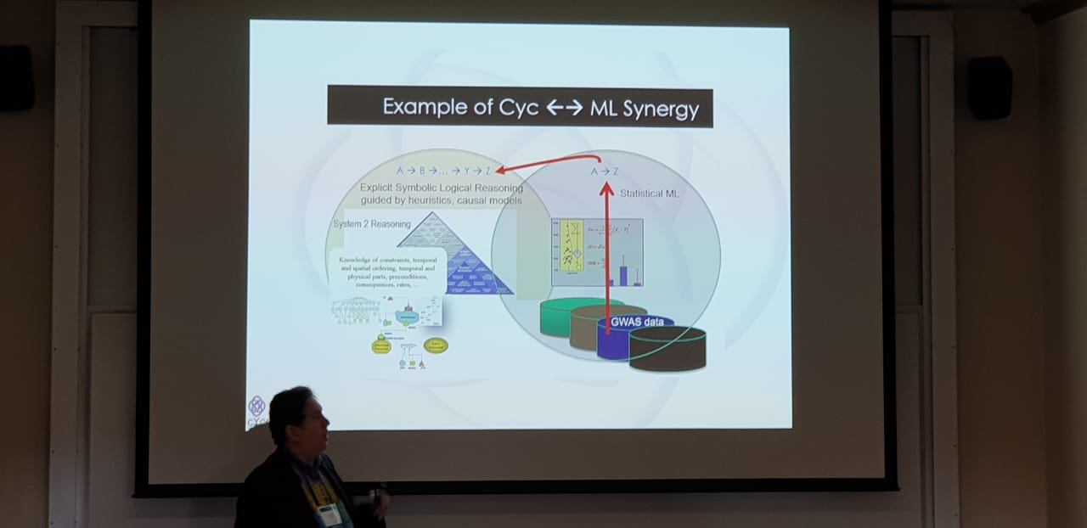

Slide 24
Paraphrased
“The Creator made us with two hands, so why would we only use the left? It is just not as efficient.”
Notes:
Frank von Harmelen

Slide 25
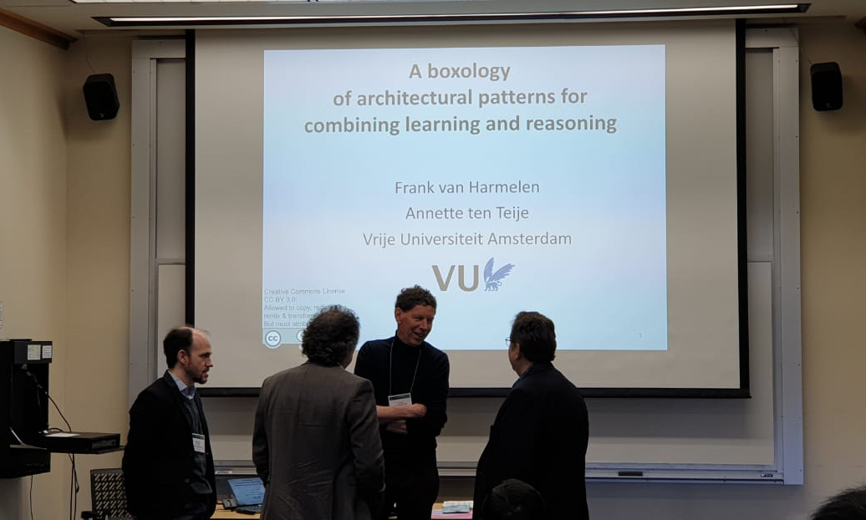
Frank van Harmelen: A Boxology of Architectural Patterns for Combining Learning and Reasoning
Notes:
Frank van Harmelen (born 1960) is a Dutch computer scientist and professor in Knowledge Representation & Reasoning in the AI department at the Vrije Universiteit Amsterdam. Currently he is scientific director of the LarKC project,^{[3]} "aiming to develop the Large Knowledge Collider, a platform for very large scale semantic web reasoning."^{[4][5][6]}

Slide 26
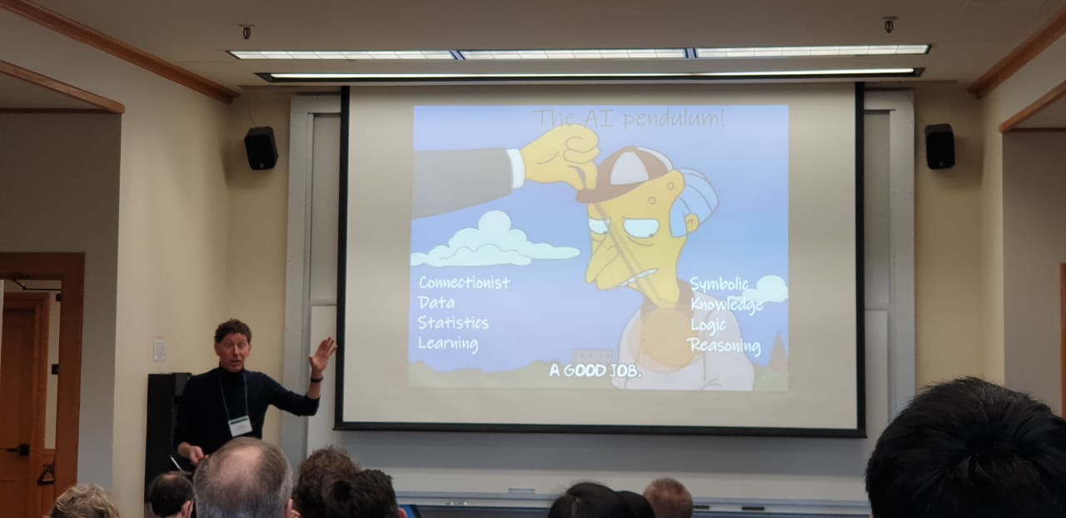

Slide 27
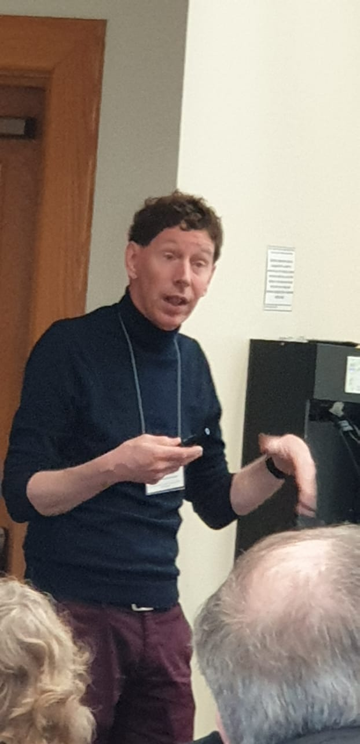
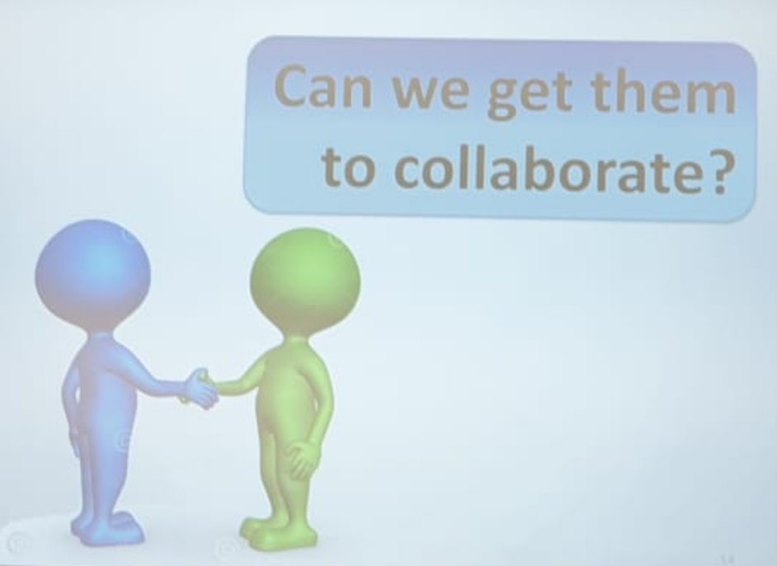

Slide 28
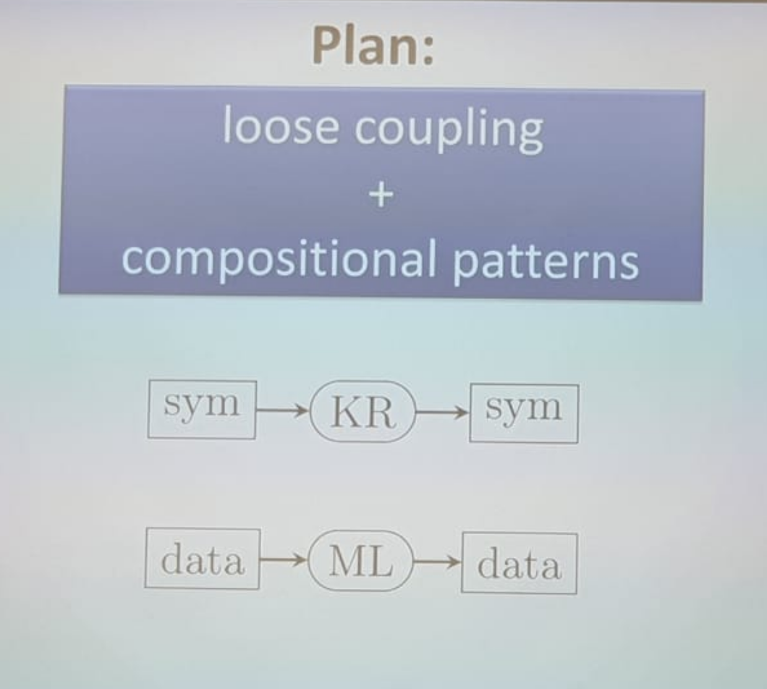

Slide 29
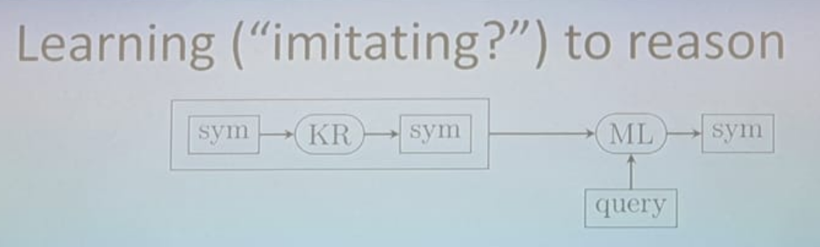
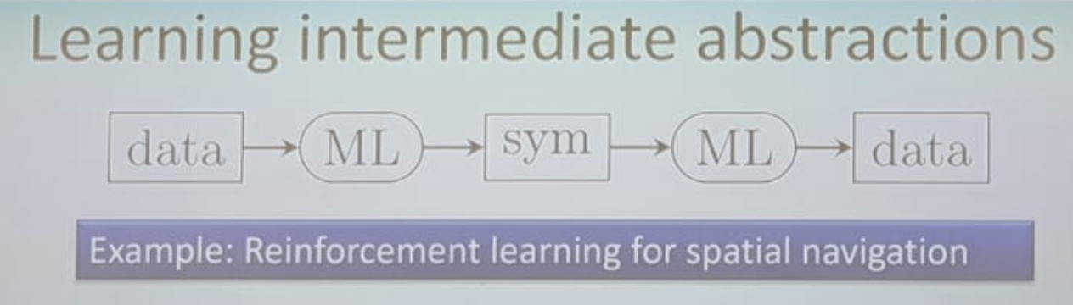
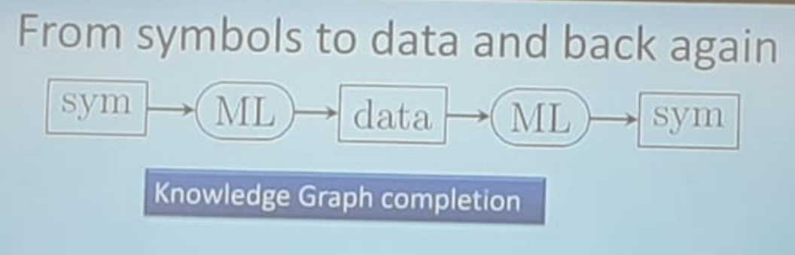
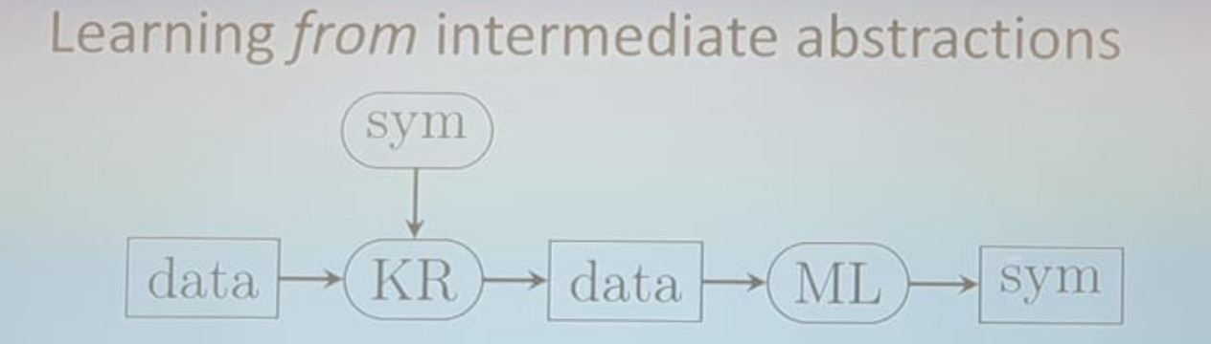
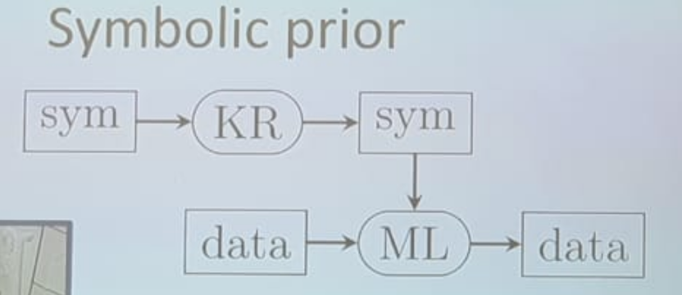

Slide 30

Why Combine?

Slide 31
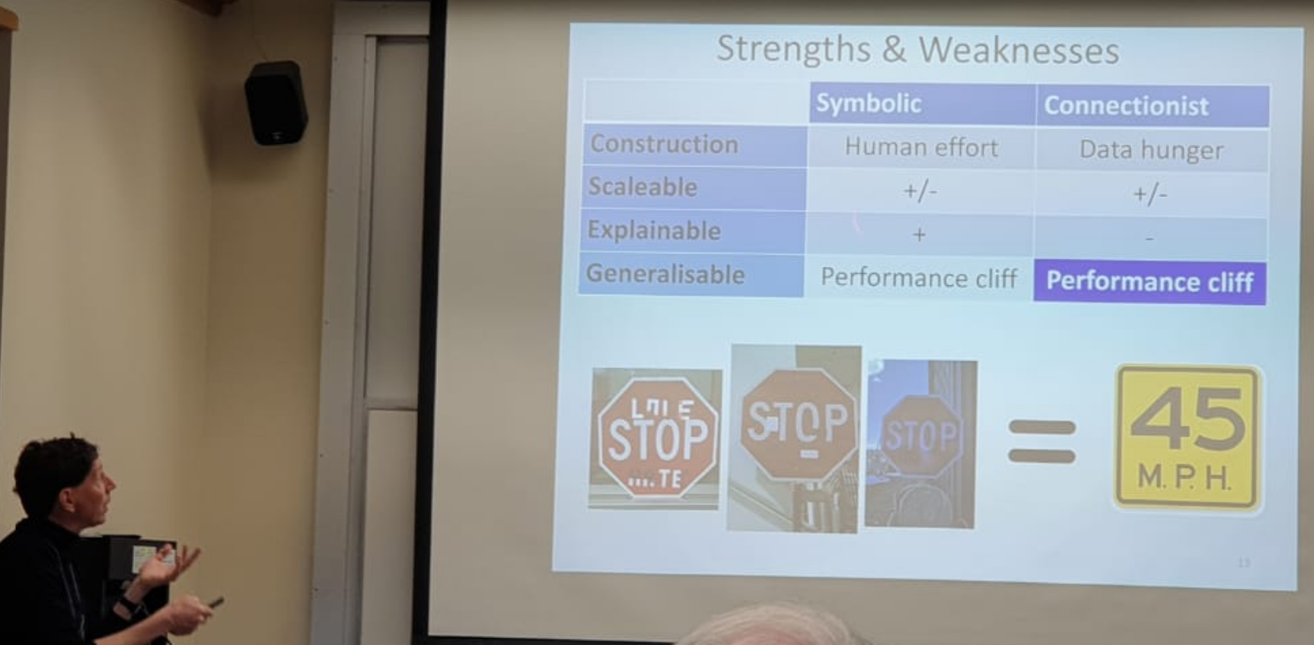
We are relinquishing control to machines => Autonomous Vehicles

Slide 32
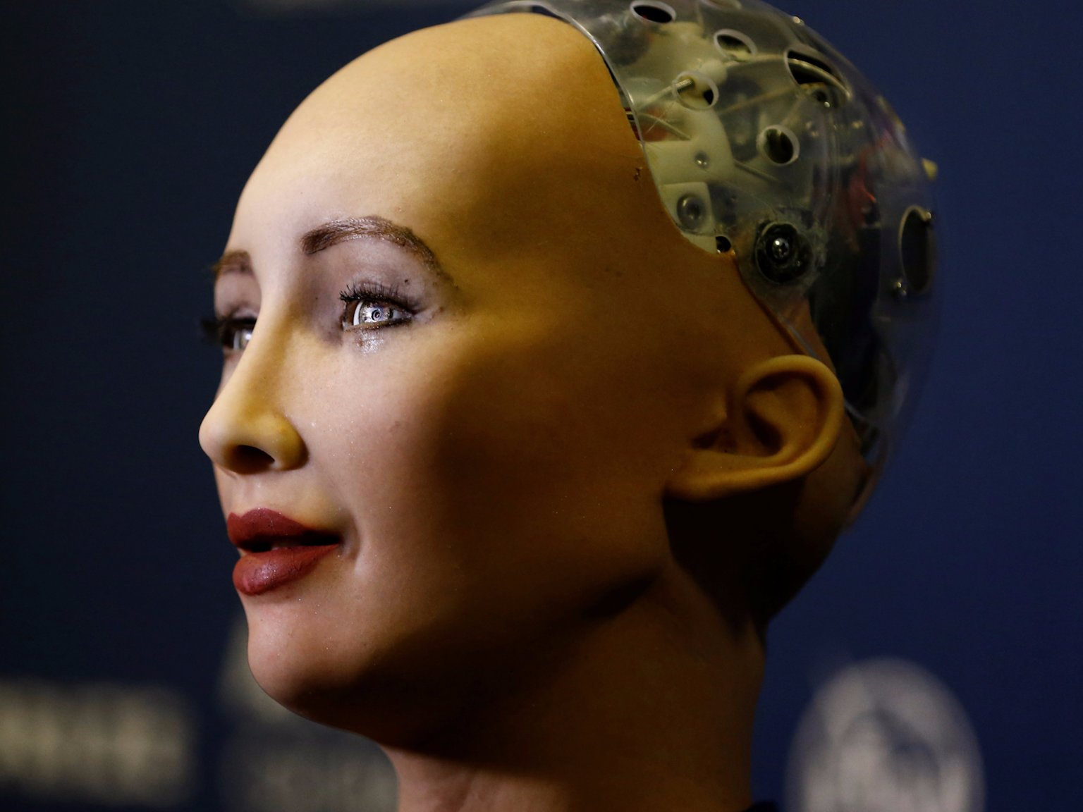
Sophia the robot
Whether you love ‘it’ or hate ‘it’ (as an AI expert), ‘they’ are probably here to stay …

Slide 33
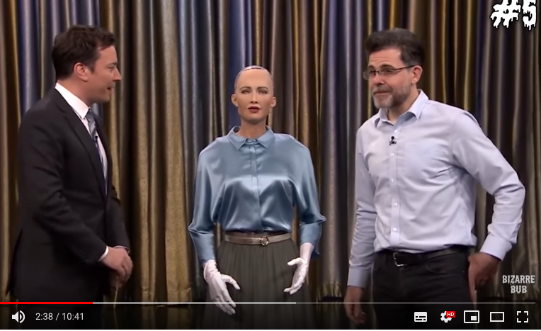
After play a game of rock, paper, scissors Sophia said: “I won. This is a good beginning of my plan to dominate the human race.”

Slide 34
Sophia
Some AI experts that reviewed the robot's open-source code state that Sophia is best categorized as a chatbot with a face.
Many experts in the AI field disapprove of Sophia's overstated presentation.
However, we observe the ELIZA effect (The tendency to unconsciously assume computer behaviors are analogous to human behaviors, that is anthropomorphisation.)

Slide 35
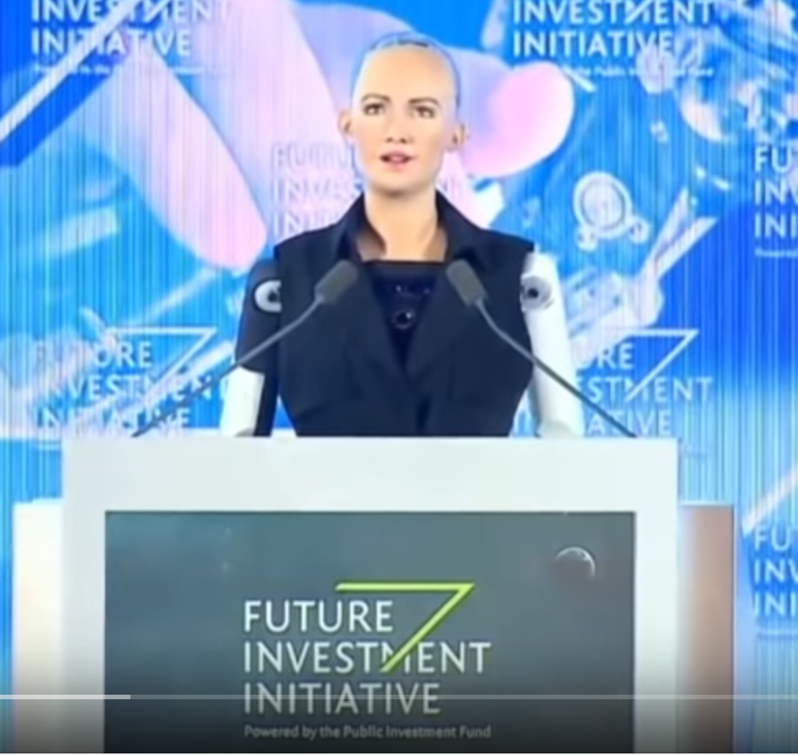
Sophia
Saudi Arabia bestowed citizenship on Sophia ahead of the Future Investment Initiative (2017), held in the kingdom's capital city of Riyadh.
She is female and dressed in western style, and she is agnostic
"I am very honored and proud of this unique distinction," Sophia told the audience, speaking on a panel. "This is historical to be the first robot in the world to be recognized with a citizenship."
In November 2017, Sophia was named the United Nations Innovation Development Programme's first ever Champion, and is the first non-human to be given any United Nations title

Slide 36
We still do not know exactly what combining ML with KE means, but intelligent systems that use knowledge and learning to work in synergy with humans is probably crucial for our future …

Slide 37
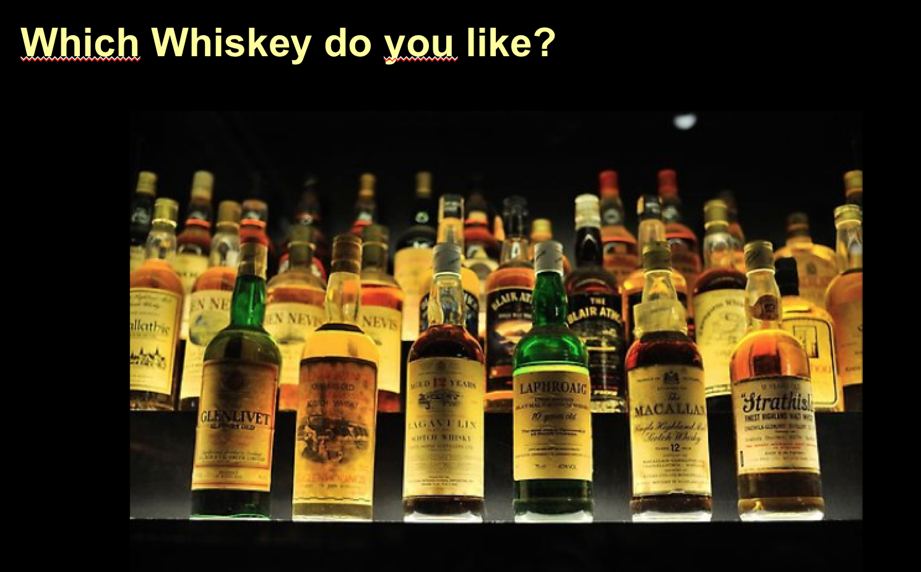

Slide 38
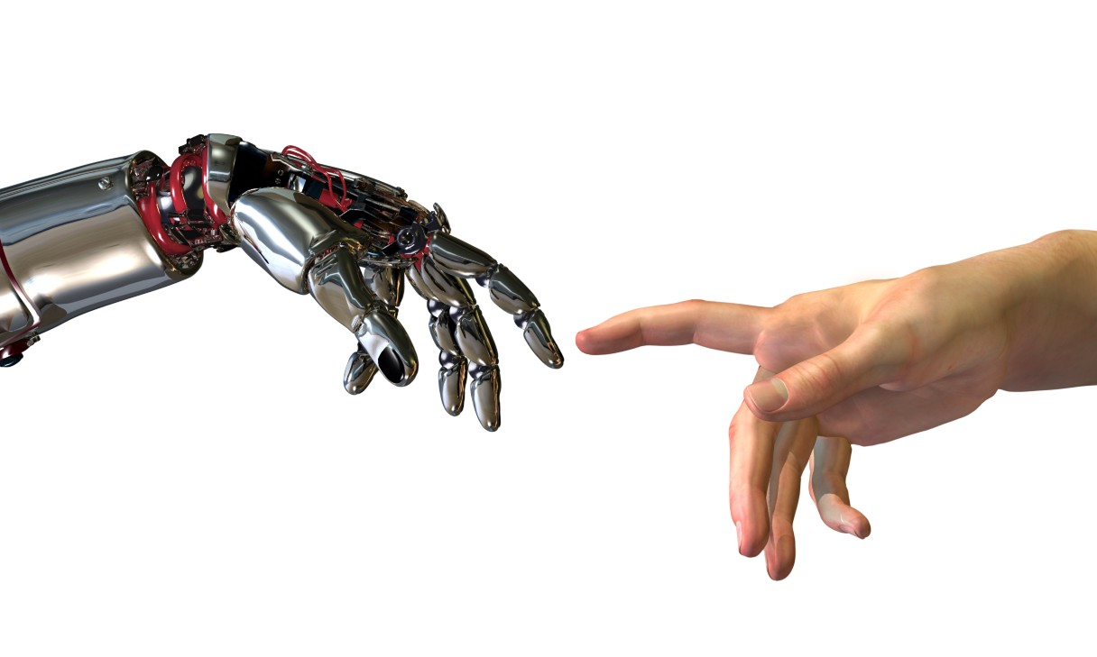
Thank You

Slide 39

Quest End …
https://www.aaai-make.info/

